Slide 1
Title of your project
Parul Institute of Computer Applications
Semester 5 Project
2020-21
Team Members
Bhavesh Thakkar-190510101166
Karan Soni-190510101161
Sunil Kumar-190511301003
Guided by:
Dr.Abhishek R. Mehta

Slide 2
INDEX
Abstract
Comparison of New System with Existing System
Technology and HW, SW Requirement Specification
Modules and its short description
Users and their role description
Class diagram
Activity diagram
Use Case
DFD
ER Diagram
Data Dictionary
Development Phase -1 Screenshots(layout / form designing)
Development Phase -2 Screenshots(layout / form design with code)
Development Phase -3 Screenshots(layout / form design with validation)
Development Phase -4 Screenshots(System with Testing)
Limitations
Future Enhancement
References & Bibliography

Slide 3
Abstract
This portal can reduce a lot of hassle in this pandemic. From the covid-19 test booking to Hospital Bed booking. User can also apply for sanitization process for house, office etc. This system would display available slots for sanitization process for the user, and they can select which one they want to choose. In these pandemic medical treatment for patients is being tough because medical beds for covid-19 in hospital are not available easily. From the use of this system patients can book medical bed for their covid-19 treatment. Patient/Customer also order oxygen cylinder for their treatment.

Slide 4
Comparison of new system with existing system
PORTAL FOR DOCTORS | EXISTING SYSTEM
Sanitization Booking | No Sanitization Booking
Hospital Bed Booking | No Hospital Bed Booking
Oxygen Booking | No Oxygen Booking

Slide 5
Technology and HW, SW Requirement Specification
Technology description
PHP: PHP is a recursive acronym for "PHP: Hypertext Preprocessor". PHP is a server-side scripting language that is embedded in HTML. It is used to manage dynamic content, databases, session tracking, even build entire e-commerce sites. ... PHP is forgiving PHP language tries to be as forgiving as possible.
HTML: Hypertext Markup Language (HTML) is the standard markup language for documents designed to be displayed in a web browser. HTML describes the structure of a web page semantically and originally included cues for the appearance of the document. HTML elements are the building blocks of HTML pages.
Bootstrap: Bootstrap is a free and open-source CSS framework directed at responsive, mobile-first front-end web development. It contains CSS- and JavaScript-based design templates for typography, forms, buttons, navigation, and other interface components.
CSS: Cascading Style Sheets is a style sheet language used for describing the presentation of a document written in a markup language such as HTML. CSS is a cornerstone technology of the World Wide Web, alongside HTML and JavaScript.

Slide 6
Technology and HW, SW Requirement Specification
Apache Sever (XAMP): XAMPP is a free and open-source cross-platform web server solution stack package developed by Apache Friends, consisting mainly of the Apache HTTP Server, MariaDB database, and interpreters for scripts written in the PHP and Perl programming languages.
Browser: A web browser (commonly referred to as a browser) is a software application for accessing information on the World Wide Web. When a user requests a web page from a particular website, the web browser retrieves the necessary content from a web server and then displays the page on the user's device.
Payment Gateway: A payment gateway is a technology used by merchants to accept debit or credit card purchases from customers. The term includes not only the physical card-reading devices found in brick-and-mortar retail stores but also the payment processing portals found in online stores.

Slide 7
Technology and HW, SW Requirement Specification
Hardware Requirements
The hardware requirements are below listed
User Side: -
Smartphone and Pc
Server Side: -
Server with high bandwidth.
PC for admin.
Software Requirements:-
Chrome and SMS Messaging App

Slide 8
Modules and its short description
Modules Description
Users/Patients:-
Covid-19 Test Booking: Users can book their covid-19 test by filling the form and users also gets the confirmation mail and message with test guild lines.
Sanitizing Process Booking: Users can book sanitizing process for their homes, office etc. Users selects sanitizing slots also and also gets confirmation mail and message.
Book Medical bed for covid-19: Users can book medical bed for covid-19 treatment. Users also gets confirmation mail and message.
Book Oxygen Cylinder: Users can order oxygen cylinder for their family. Users also gets confirmation mail and message.

Slide 9
Users and their role description
Database Administrator:-
Add Laboratory’s: Database Administrator can add and remove laboratories in the system.
Add Oxygen Suppliers: Database Administrator can add and remove Oxygen Suppliers in the system.
Add Hospitals: Database Administrator can add and remove Hospitals in the system.
Add Cities: Database Administrator can add and remove cities in the system.
Laboratory Staff:-
View and Manage covid-19 & Sanitization Bookings:-It can View and Manage the Covid-19 & Sanitization Bookings.

Slide 10
Users and their role description
Oxygen Suppliers:-
View and Mange Oxygen cylinder Bookings:-It can view and Manage the Oxygen cylinder Bookings.
Hospital Staff:-
View and Manage Hospital Bed Bookings:-It can view and Manage the Bed Bookings.

Slide 11
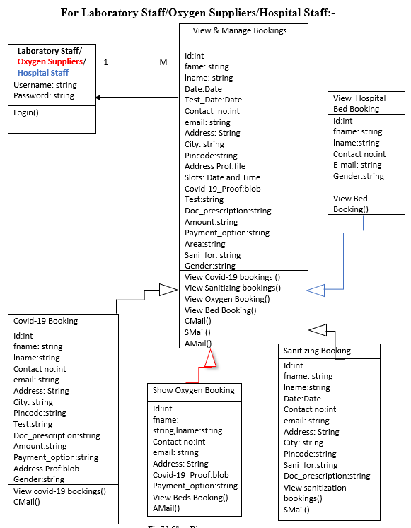
Class diagram

Slide 12
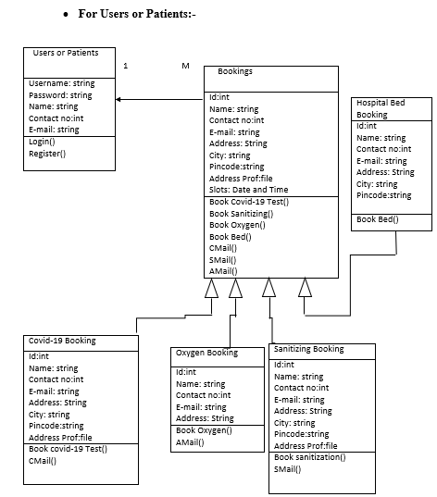
Class diagram

Slide 13
Activity diagram(User and Patient)

Slide 14
Activity diagram(User and Patient)

Slide 15
Activity diagram(User and Patient)

Slide 16
Activity diagram(User and Patient)

Slide 17
Activity diagram(User and Patient)

Slide 18
Activity diagram(Laboratory Staff, Oxygen Suppliers, Hospital Doctors)

Slide 19
Activity diagram(Laboratory Staff, Oxygen Suppliers, Hospital Doctors)

Slide 20
Activity diagram(Laboratory Staff, Oxygen Suppliers, Hospital Doctors)

Slide 21
Activity diagram(Laboratory Staff, Oxygen Suppliers, Hospital Doctors)

Slide 22
Use case diagram

Slide 23
Data Flow Diagram(DFD)

Slide 24
Data Flow Diagram(DFD)

Slide 25
Data Flow Diagram(DFD)

Slide 26
Data Flow Diagram(DFD)

Slide 27
Data Flow Diagram(DFD)

Slide 28
Data Flow Diagram(DFD)

Slide 29
Data Flow Diagram(DFD)

Slide 30
Data Flow Diagram(DFD)

Slide 31
Data Flow Diagram(DFD)

Slide 32
Data Flow Diagram(DFD)

Slide 33
Data Flow Diagram(DFD)

Slide 34
Data Flow Diagram(DFD)

Slide 35
Data Flow Diagram(DFD)

Slide 36
Data Flow Diagram(DFD)

Slide 37
Data Flow Diagram(DFD)

Slide 38
Data Flow Diagram(DFD)

Slide 39
Data Flow Diagram(DFD)

Slide 40
Data Flow Diagram(DFD)

Slide 41
Data Flow Diagram(DFD)

Slide 42
ER diagram

Slide 43
ER diagram

Slide 44
ER diagram

Slide 45
ER diagram

Slide 46
ER diagram

Slide 47
DATA DICTONARY

Slide 48
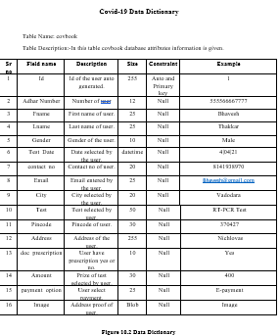
DATA DICTONARY

Slide 49
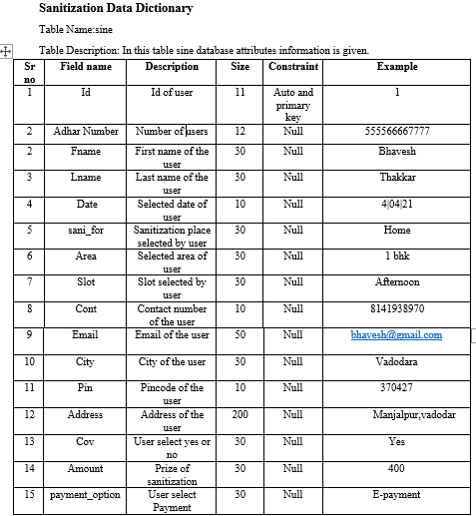
DATA DICTONARY

Slide 50
DATA DICTONARY

Slide 51
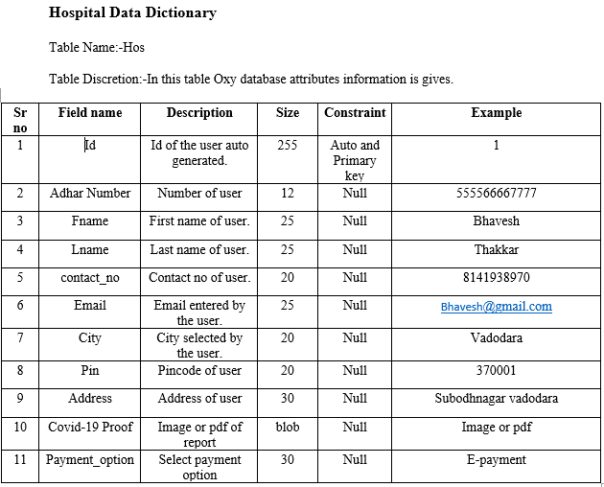
DATA DICTONARY

Slide 52
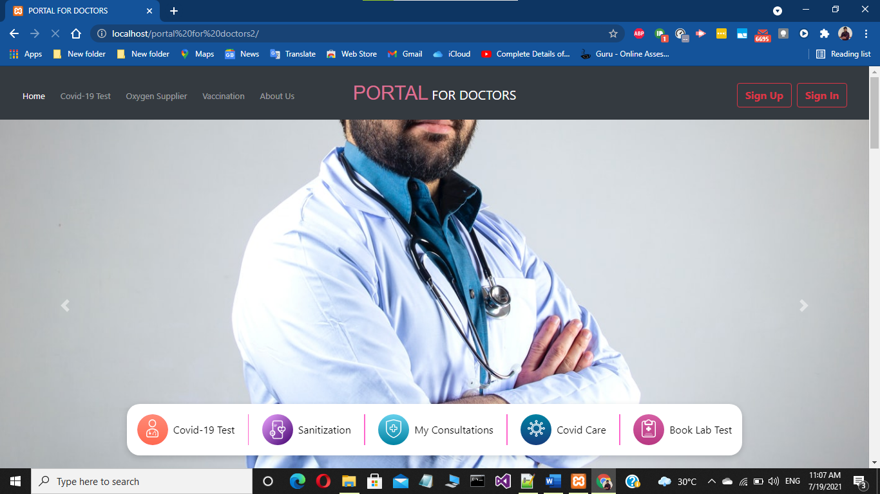
Development Phase -1 Screenshots(layout / form designing)

Slide 53
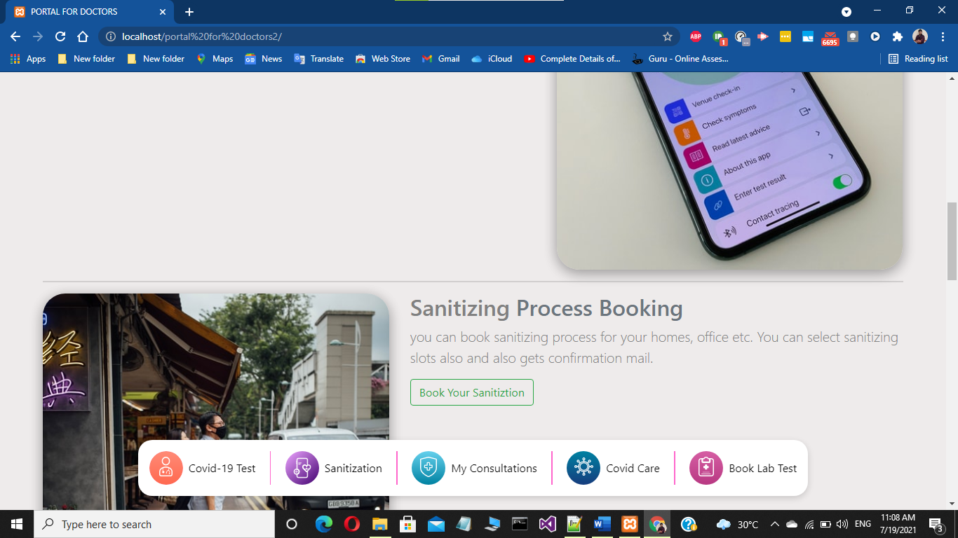

Slide 54
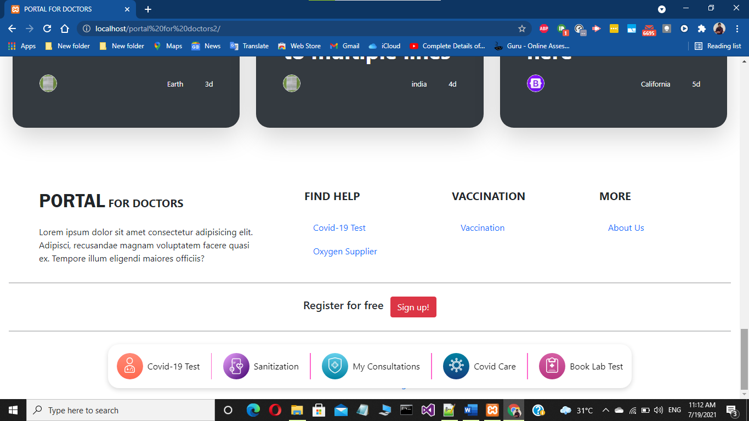

Slide 55
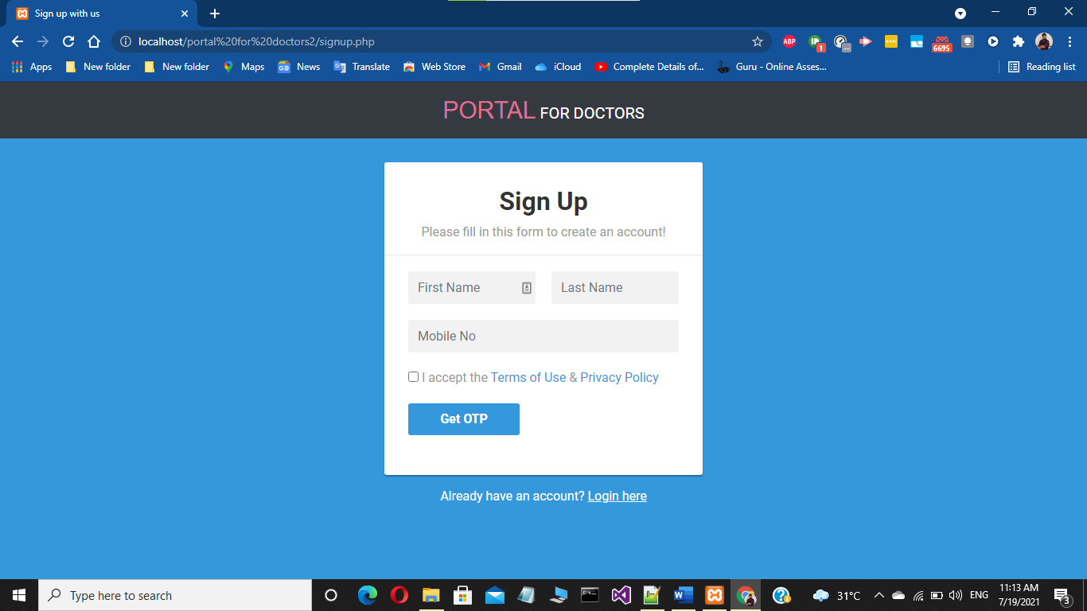

Slide 56
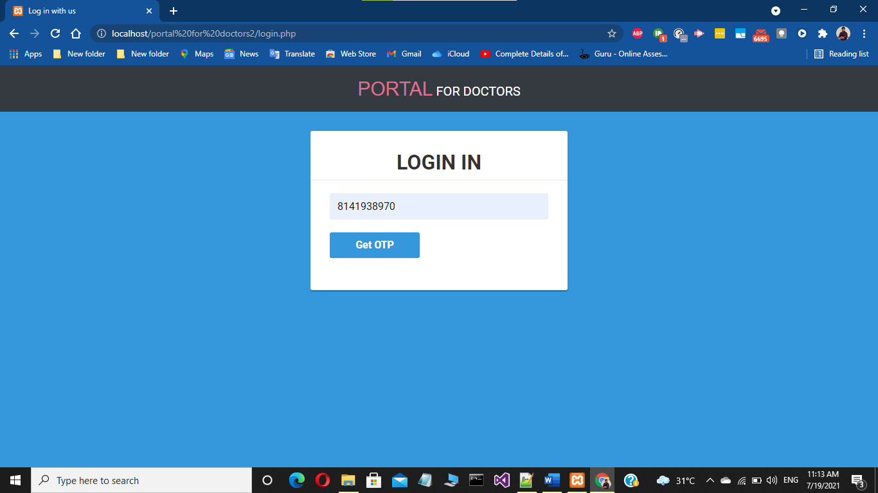

Slide 57
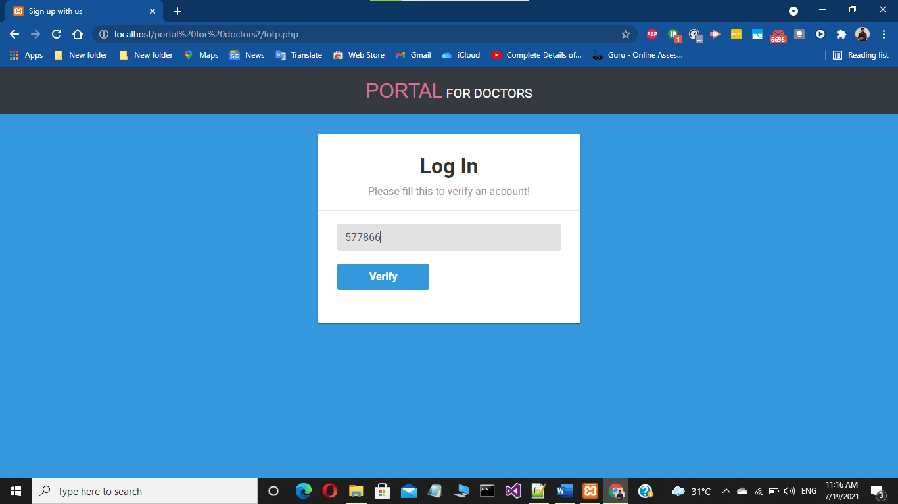

Slide 58
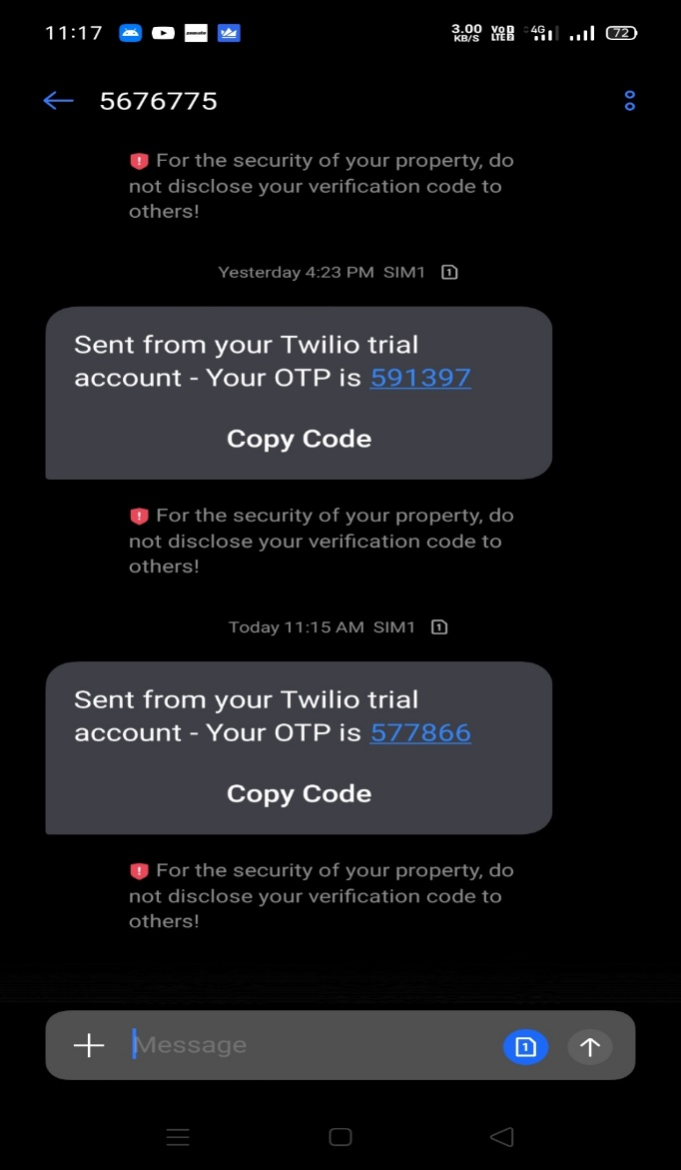

Slide 59
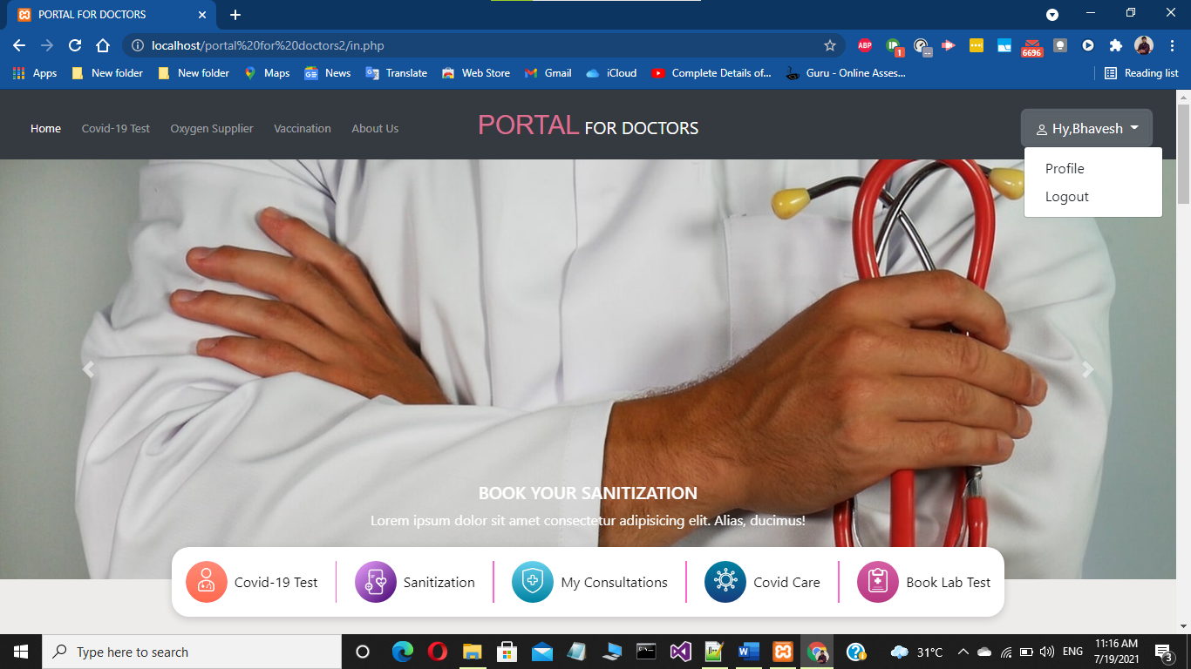
Development Phase -2 Screenshots(layout / form design with code)

Slide 60
Development Phase-3 Screenshots (layout / form designing with validation)

Slide 61
Development phase- 4 Screenshots (system with testing

Slide 62
Limitations

Slide 63
Future Enhancement
NOTE : It should be the content that will add more value/functionality to your system in future.

Slide 64
References & Bibliography

Slide 65
Thank you !!!

